Slide 1

Olessia Bauer report
February 2026

Slide 2
Stakeholders meeting (D28, CEC28, SCA, and QBP), Feb. 4, 2026
Problems:
1. SCA (school construction authority) does not honor CEC28 recommendations for capital projects.
2. Principals experience lack of notifications/updates throughout various stages of school construction projects.
Possible solutions:
Resolution requiring SCA honor CEC recommendations.
Creation of a school construction projects tracker accessible to principals and CEC 28 members.

Slide 3

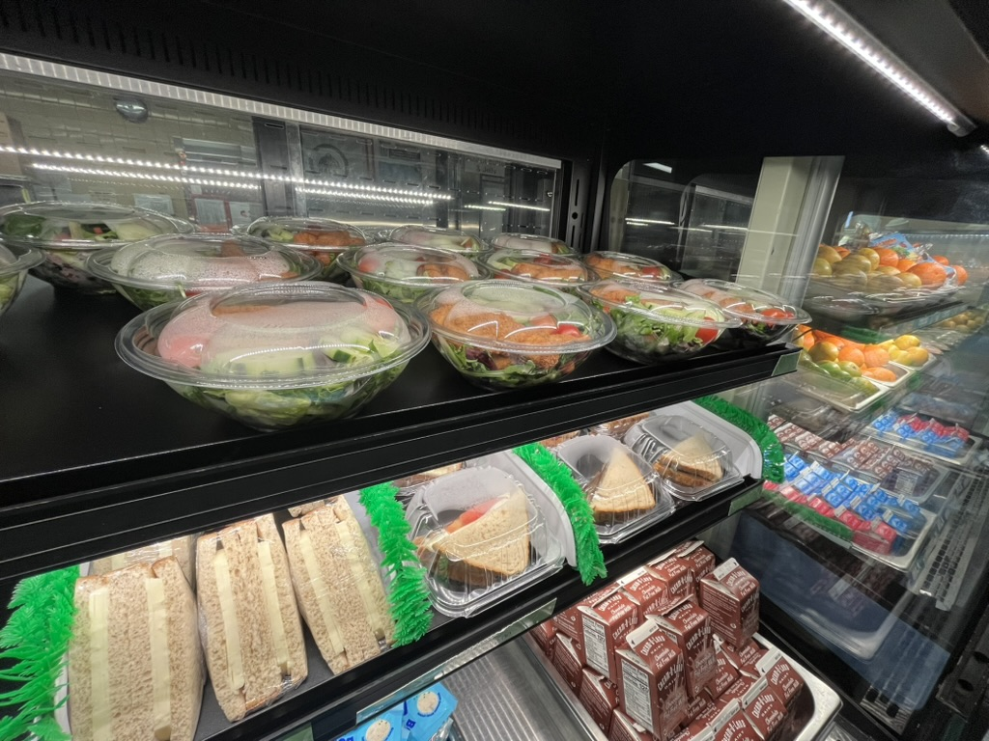
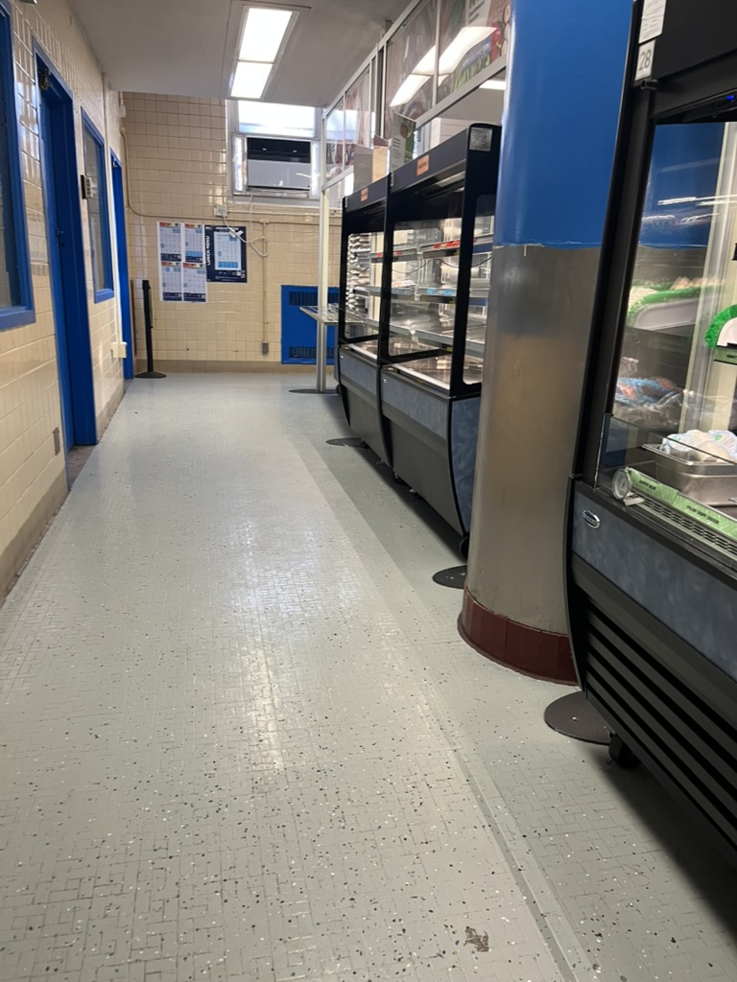
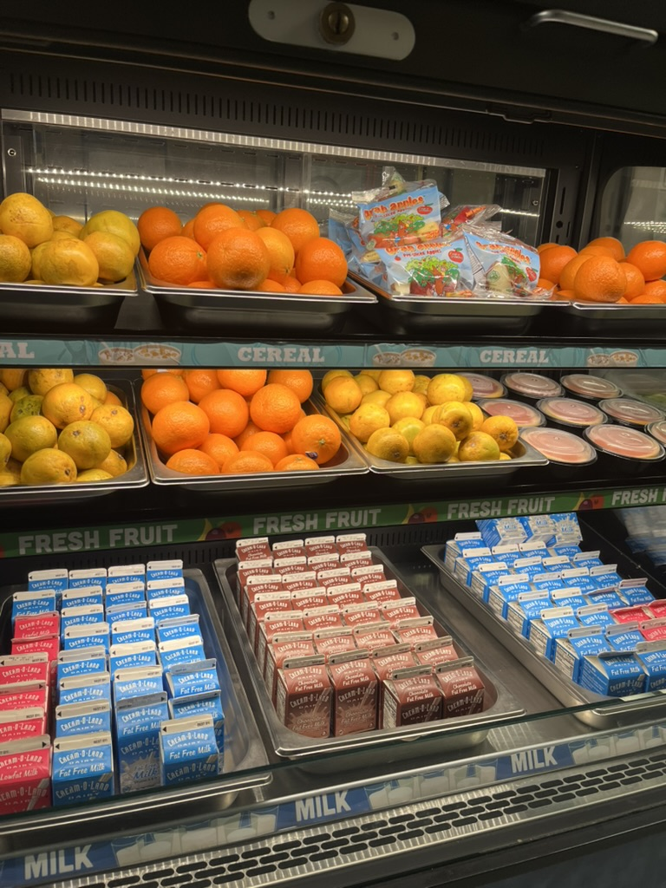
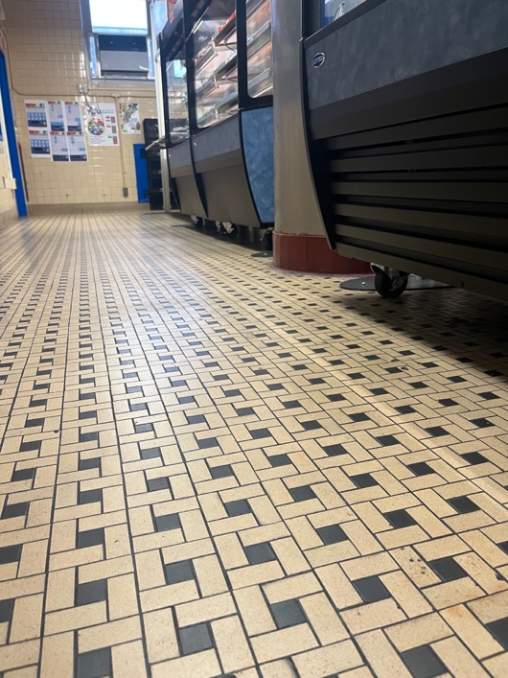
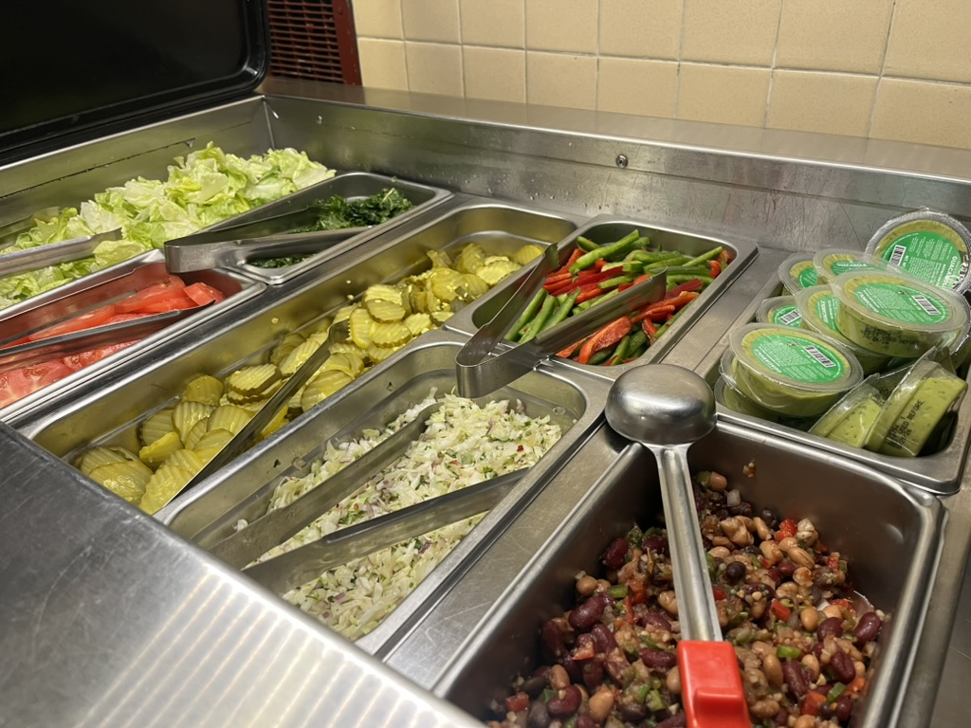
M.S. 217 kitchen and cafeteria visit
Old floors
New floors

Slide 4

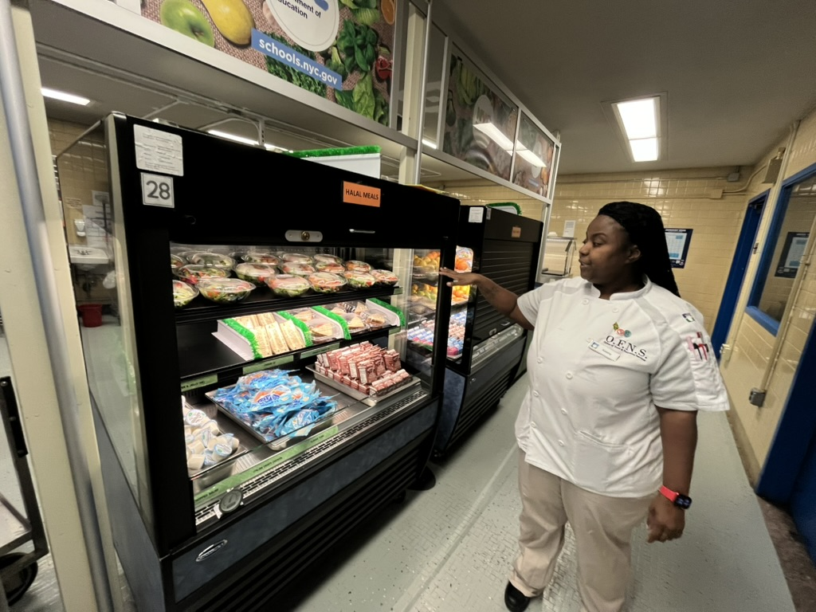
Kitchen staff requested that Q56 and Q24 bus stops return to the old schedule

Slide 5
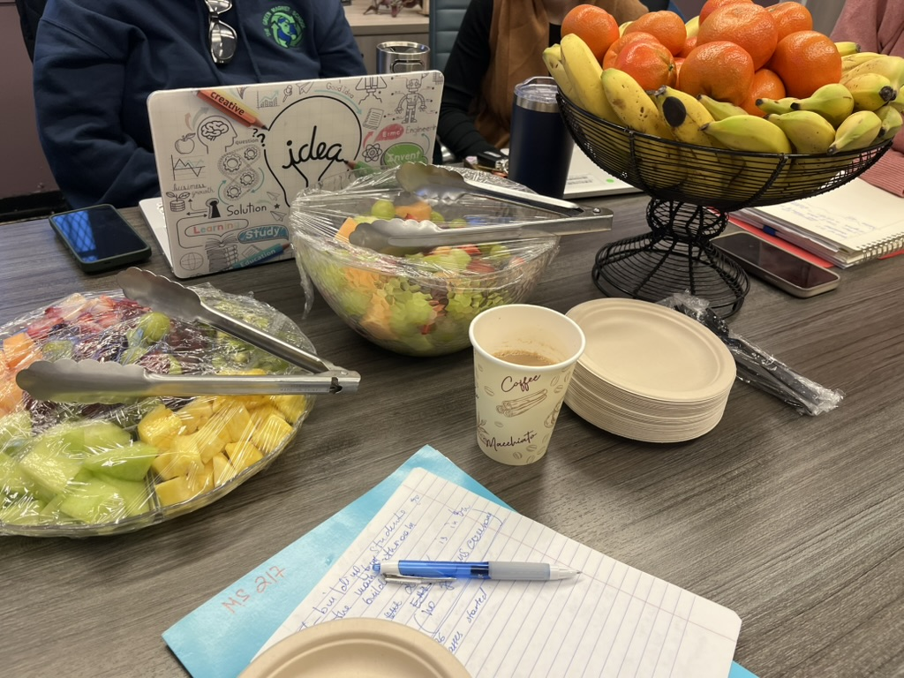
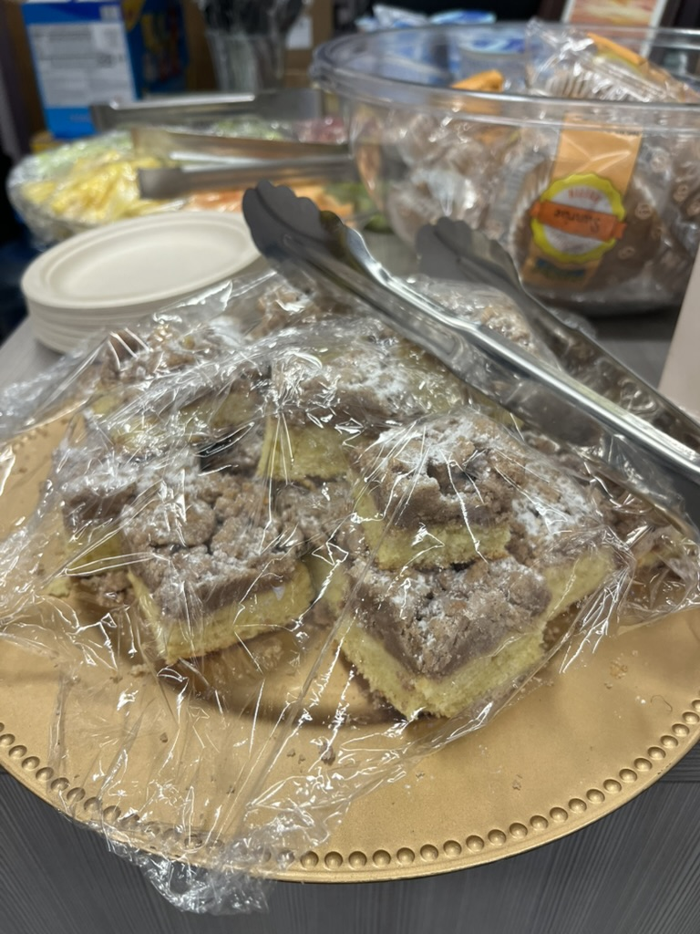
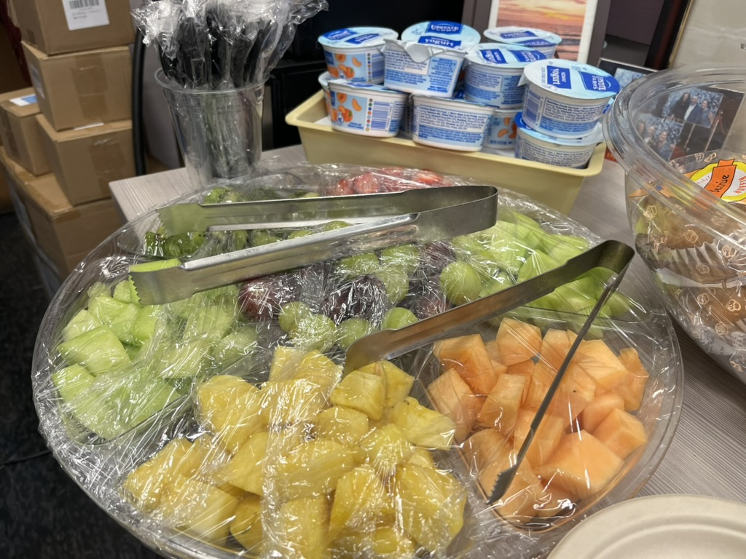
Students cooking class

Slide 6
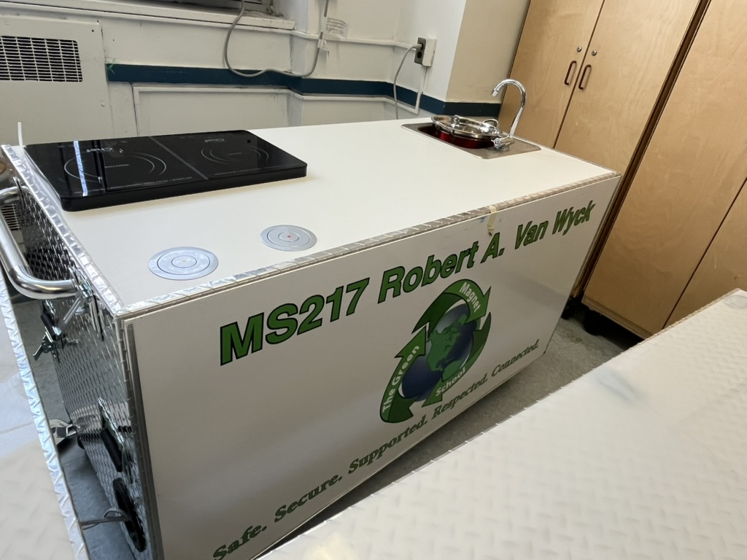
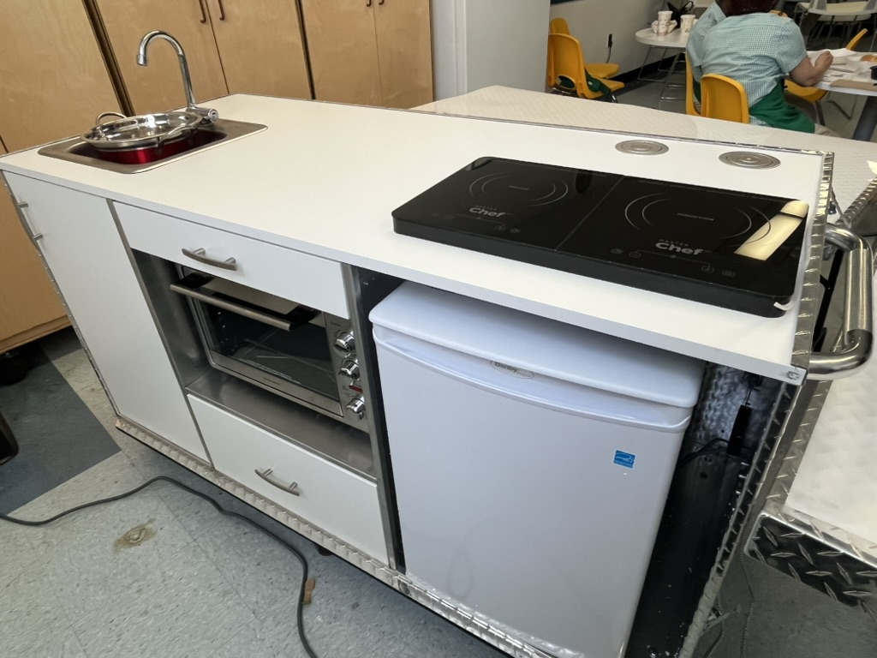
Mobile kitchen for students

Slide 7
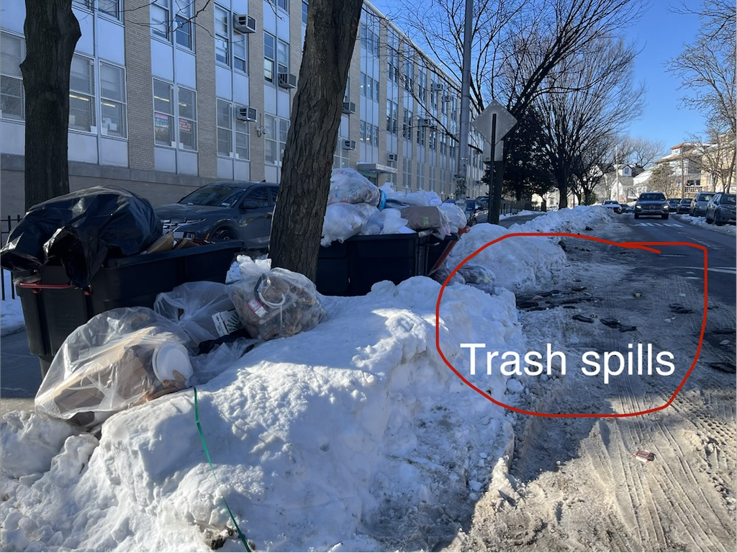
M.S. 217 requested that trash is picked up daily instead of twice a week

Slide 8
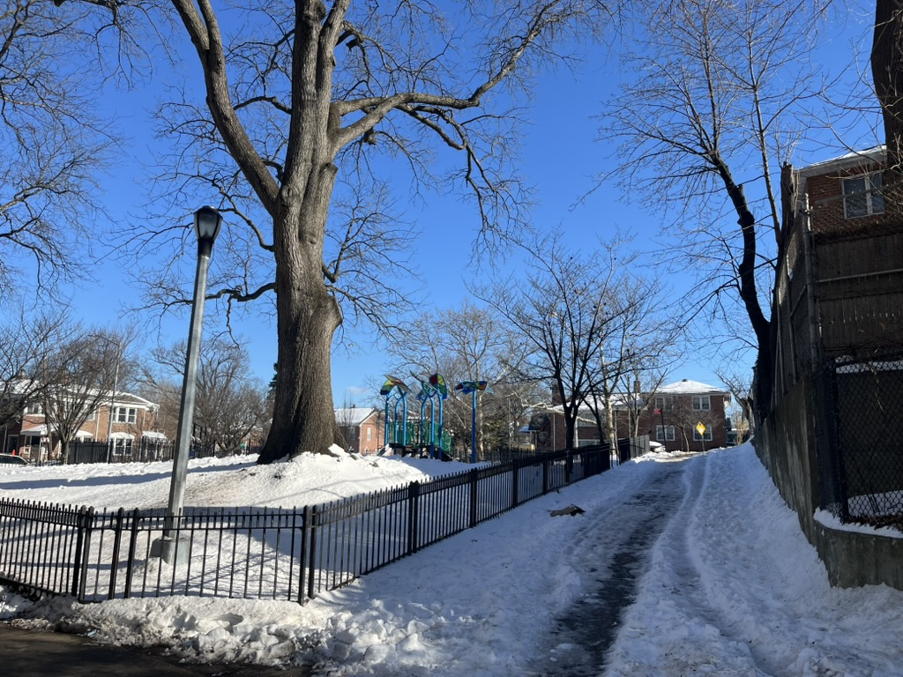
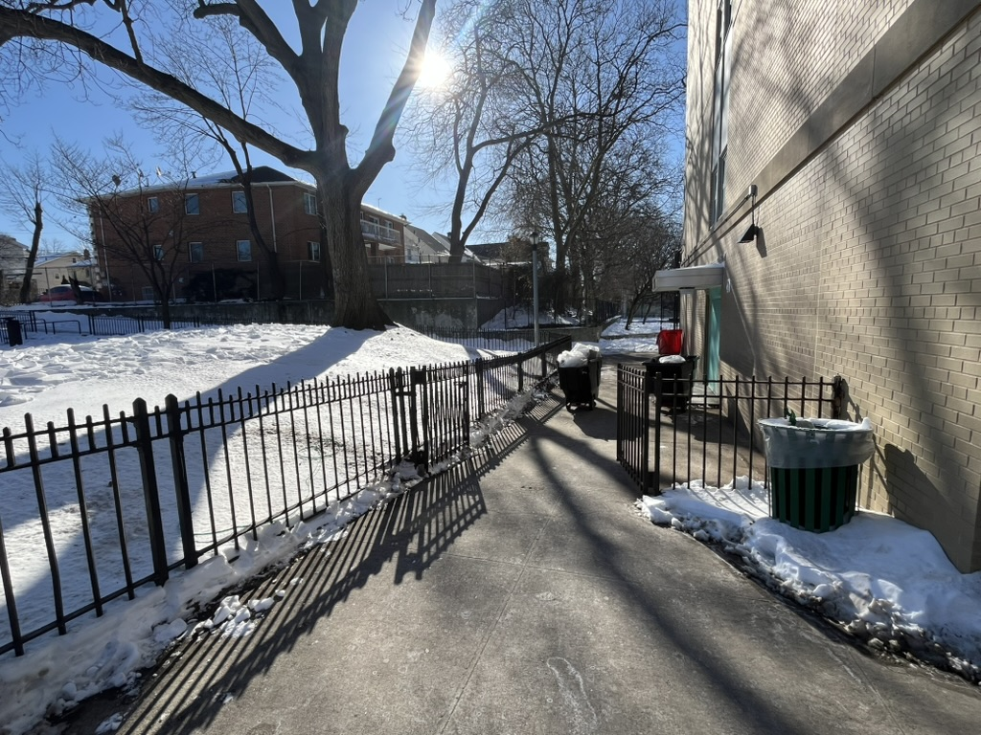
Controversial tree that stands (or not) in the way of construction at M.S.217

Slide 9

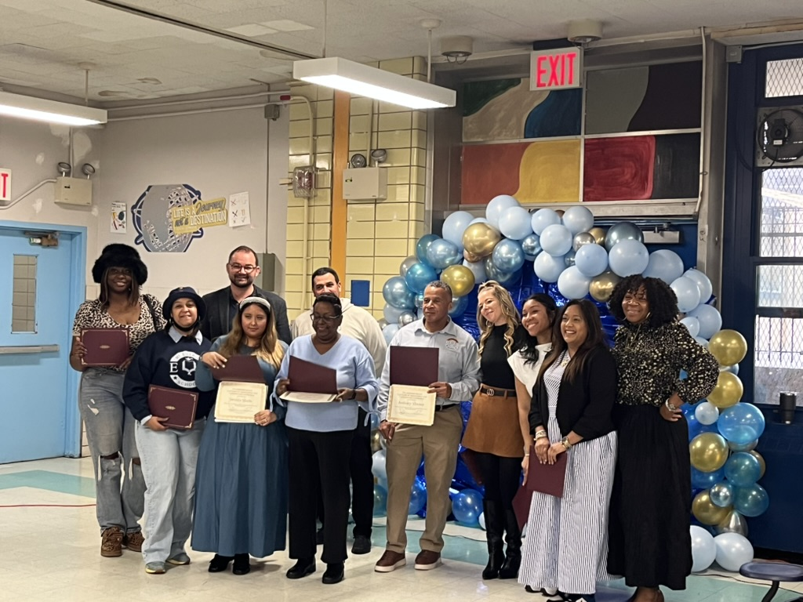

M.S. 287 awards ceremony for students and staff

Slide 10
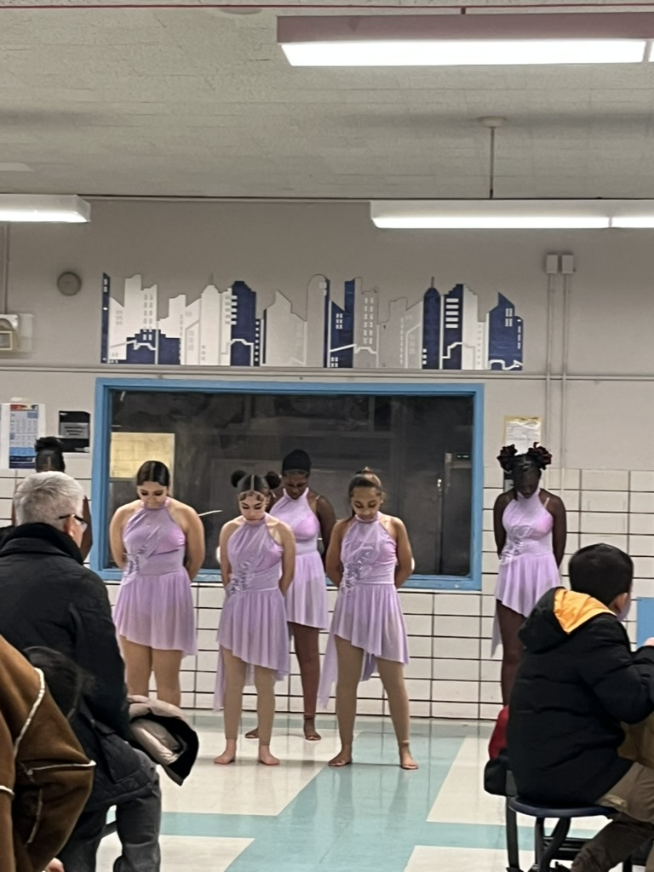

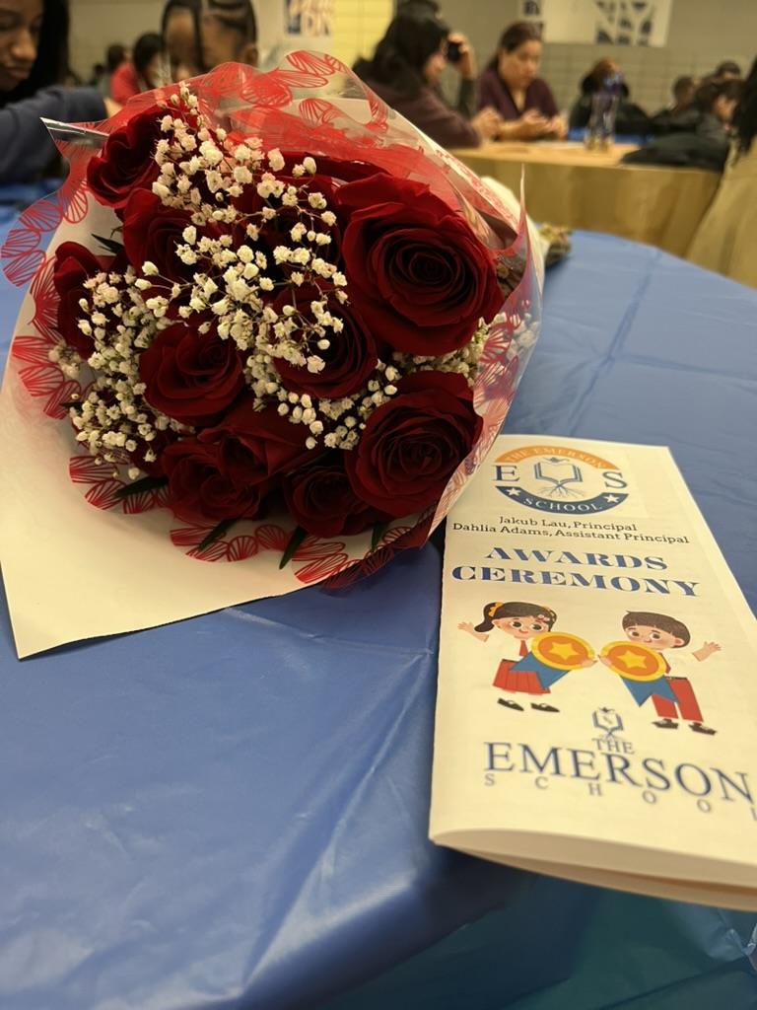
M.S. 287 Student performance

Slide 11
M.S. 287 project updates
1. HVAC system installation sponsored by Reso A, budget is $550,000 (start date and other details are needed). Per SCA this scope will begin in 2026.
2. Jamaica Neighborhood Plan (more details are needed). There are no details to share as this a Department of City Planning project. The Office of the Queens Borough President has been involved, and we have relayed a number of schools within the perimeters of the plan.
3. Gym renovation sponsored by Natasha Williams, budget is $2,000,000 (start date and other details are needed). Given that this is not a project, SCA has not relayed this information. However, happy to inquire.
4. Restroom upgrades sponsored by a Council Member, approved in November, budget is $1,500,000 (start date and other details are needed). Given that this is not a project, SCA has not relayed this information. However, happy to inquire.
Projects 3 & 4 are both funded under the Jamaica Neighborhood plan. Once funding is released to SCA we will reach out to schools quickly to begin planning.

Slide 12

J.H.S 157 updates
Classroom size – 1720 students plus 25
Annex
Bathroom updates – 2nd floor, no plumbing

Slide 13

Last slide:)
Empowerment of parent leaders is achieved through timely training on fiscal, legal, and ethical responsibly.
Dr. Ruby Crew, NYC DOE Chancellor (1995-1999/2000) – 15 to 20 day training was provided to parent leaders to understand the system and their job.

